Slide 1

Total Accounting

Slide 2
 | A Accounting |  | S Accounting |  | Total Accounting
Accounting Module
Quotation, Invoice, CN
SST Module
Multi-Currency
Track Inventory
Track Product Variant
Product Profit Margin
Build in report designer for desired printing format eg PO, Invoice & etc
Multi Payment
Paperless invoice ,Quotation Receipt (Whatsapp)
Pivot /Chart BI analysis
User | RM 10 |  | RM 60 |  | RM 30
RENEWAL | 500 |  | 800 |  | 650
 | RM 140/mth | RM 235O | RM 109 /mth | RM 1790 | RM 250 /mth | RM 2000+40
x
x
x
x
x
x
x
x
x
x
x
x
x
x
x
x
x
x
X
x
x
X
x
x
x
x
X
X

Slide 3
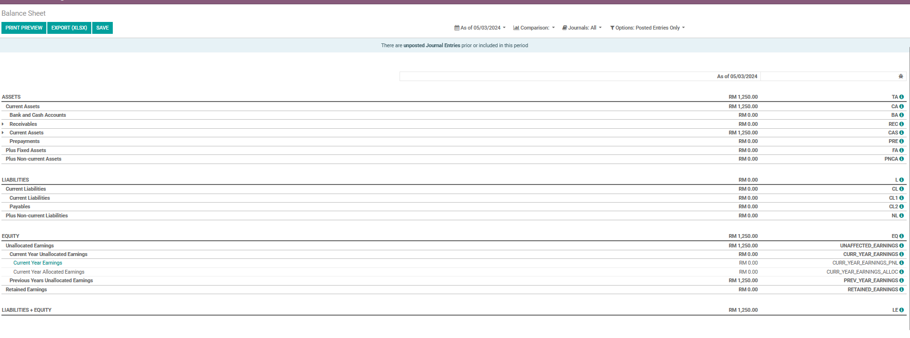
Balance sheet

Slide 4
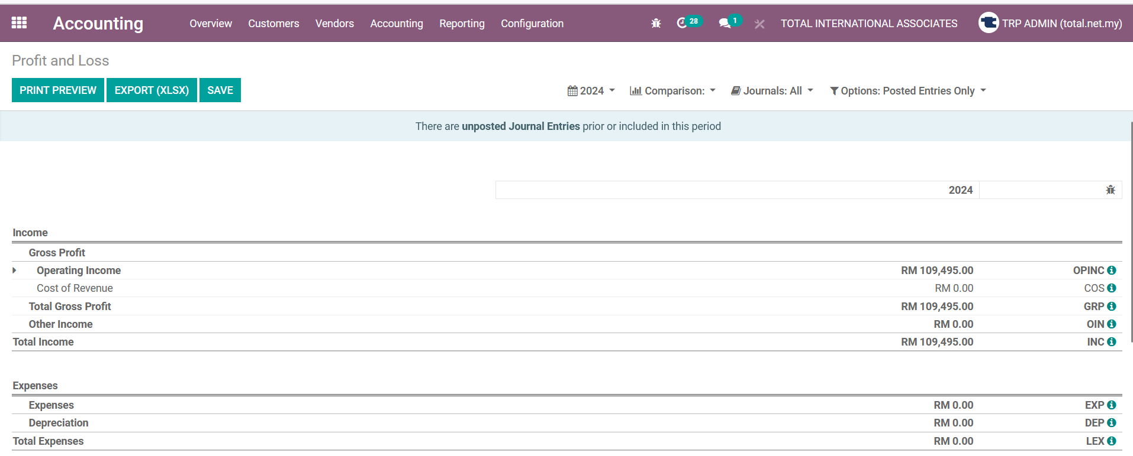
Profit & loss

Slide 5
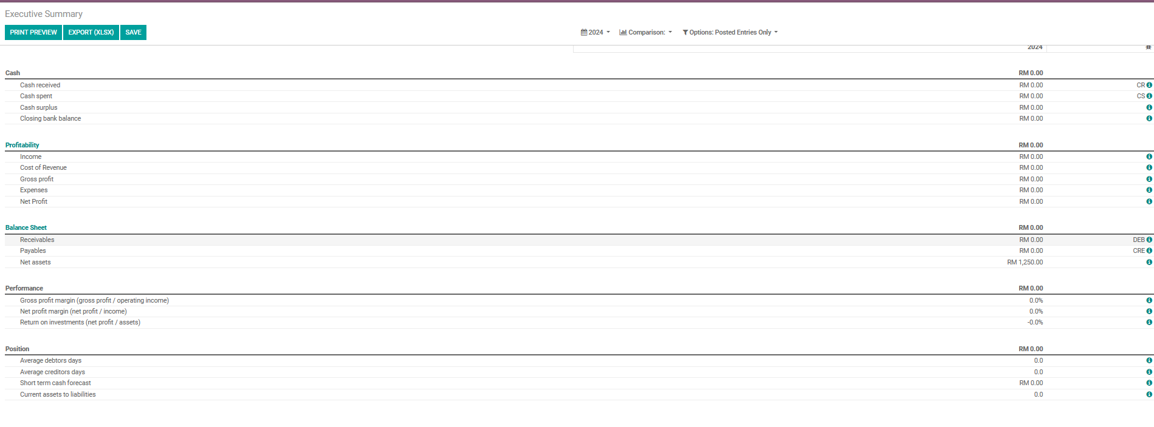
Executive summary

Slide 6
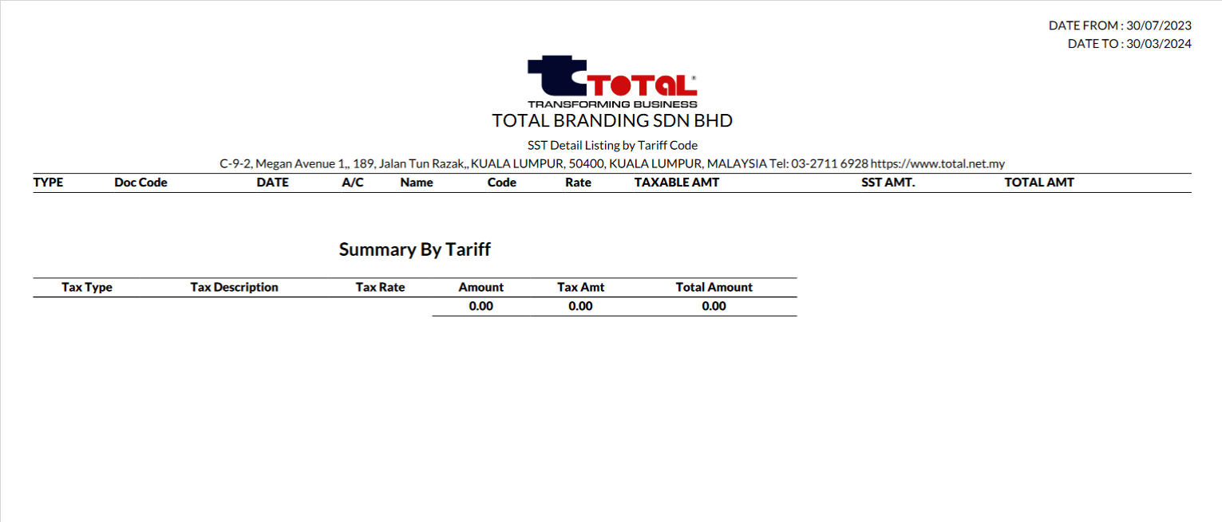
Sst listing

Slide 7
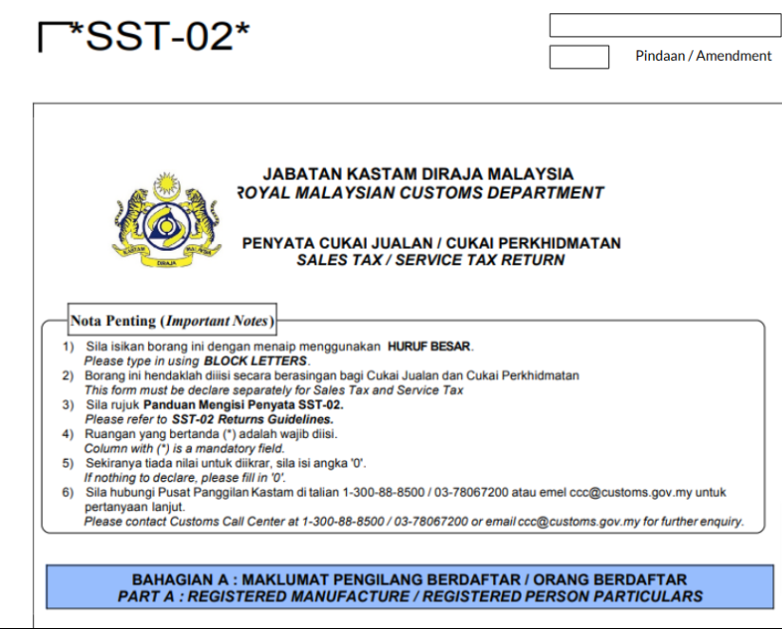
Sst 02

Slide 8
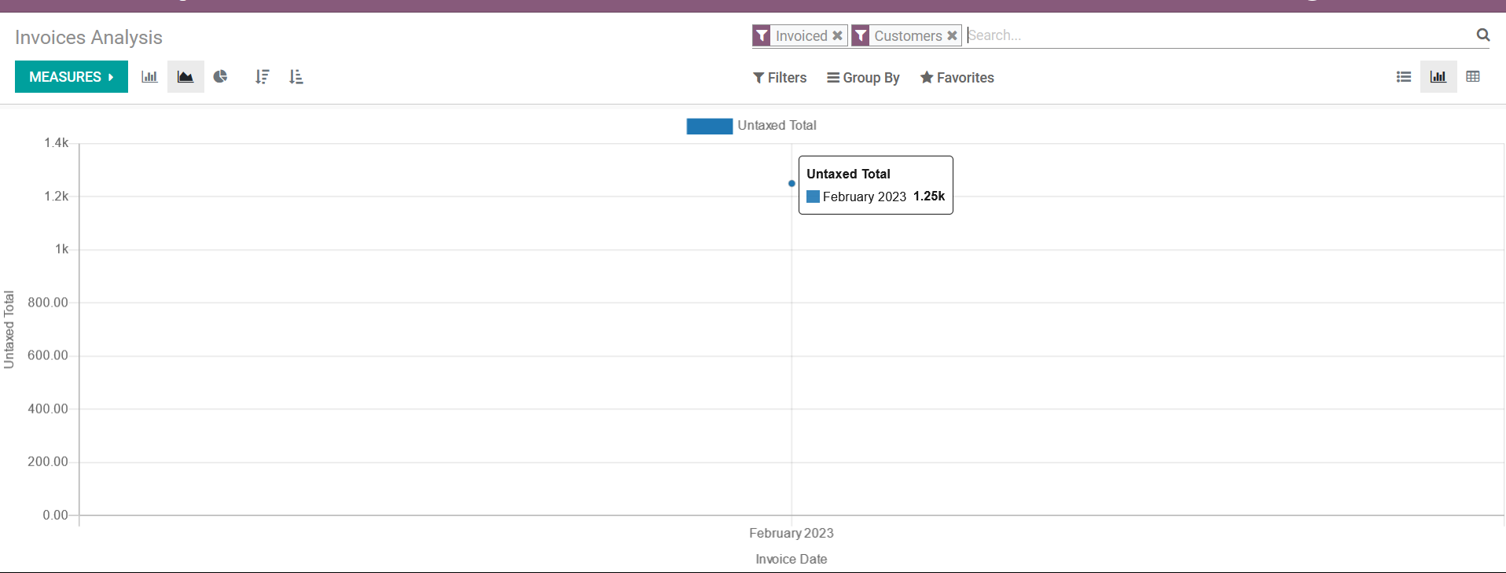
Analysis reporting /dashboard

